Slide 1
Processor Design
CT213 – Computing Systems Organization

Slide 2
Content
Processor Design
  Instruction set architecture
  Micro-architecture
Instruction set architecture
  CISC vs. RISC
  Data types
  Instruction formats
  Addressing modes
  Multimedia Vector Instructions
  Instruction set design
Processor Micro-architecture
  Review of general structure
  Execution Units
  Microprogramming
  Register file design

Slide 3
Processor Design
Instruction Set Architecture
  Design of the set of operations that the processor executes and includes:
    Choice of programming model
    Number and designation of registers
    Addressing modes – how data is accessed
Processor Micro-Architecture
  Describes how the instructions are implemented and includes:
    How long it takes to execute instructions
    How many instructions can be executed at a time
    How processor modules are designed

Slide 4
Instruction Set Architecture
Defines any aspects of the processor that an assembly language programmer needs to know, in order to write a correct program
Specifies:
  The registers accessible to the programmer, their size and the instructions in the instructions set that can use each register
  Information necessary to interact with the memory
    Certain microprocessors require instructions to start only at specific memory locations; this alignment of the instructions will be part of the instruction architecture
  How microprocessor reacts to interrupts
    Some microprocessors have interrupts, that cause the processor to stop what is doing and perform some other preprogrammed functions (interrupt routines)
Notes:
Instruction set architecture – defines any aspects of the processor that an assembly language programmer needs to know, in order to write a correct program

Slide 5
RISC vs. CISC (1)
The believe that better performance would be obtained by reducing the number of instruction required to implement a program, lead to design of processors with very complex instructions (CISC)
  CISC – Complex Instruction Set Computers
As compiler technologies improved, researchers started to wonder if CISC architectures really delivered better performances than architectures with simpler instruction set
  RISC – Reduced Instruction Set Computers

Slide 6
RISC vs. CISC (2)
CISC
  Fewer instructions to execute a given task than RISC
  Programs for CISC take less storage space than programs for RISC
  Arithmetic or other instructions may read their operand from memory and could write the result in memory
RISC
  Simpler instructions, faster execution speeds per instruction, more instructions executed in same amount of time than CISC
  Cheaper to implement (simple instruction set results in simple implementation internal micro-architecture)
  Load/Store architecture – only load and store are used to access the external memory
Notes:
It is difficult to say which architecture is better. Over the last 20 years, RISC architectures have taken useful instructions from CISC architectures and included them in their instruction sets. CISC architectures have dropped instructions that were not useful (too complex).

Slide 7
RISC vs. CISC (3)
RISC | CISC
LD R4, (R1) LD R5, (R2) ADD R6, R4, R5 ST (R3), R6 | ADD (R3), (R2), (R1)
Addition of two operands from memory, with result written in memory, in RISC and CISC architectures
Having an operation broken into small instructions (RISC) allows the compiler to optimize the code
  i.e. between the two LD instructions (memory is slow) the compiler can add some instructions that don’t need memory access
The CISC instruction has no option but to wait for its operands to come from the memory, potentially delaying other instructions
Notes:
Te difference between load/store architectures and architectures that can merge memory references with other operations is an excellent example of trade-offs between RISC and CISC architectures. A RISC architecture requires a few load/store instructions to bring the operands from the memory and save the result in the memory. However, the hardware required to implement the CISC processor would be more complex than the hardware required to implement the RISC processor. The CISC processor requires a longer cycle time or requires a few cycles to implement one instruction.

Slide 8
Instruction types (review)
Data Transfer Instructions
  operations that move data from one place to another
  These instructions don’t actually modify the data, they just copy it to the destination
Data Operation Instructions
  Unlike the data transfer instructions, the data operation instructions do modify their data values
  They typically perform some operation using one or two data values (operands) and store the result
Program Control Instructions
  Jump or branch instructions used to go in another part of the program; the jumps can be absolute (always taken) or conditional (taken only if some condition is met)
  Specific instructions that can generate interrupts (software interrupts)

Slide 9
Data types (1)
A microprocessor has to operate with multiple data types;
  the designer has to include different instructions to perform the same operation on different data types
Numeric data representation:
  Integer representation
    Unsigned representation: n bit value range from 2^{n} -1 to 0
    Signed representation: n bit value range from -2^{n-1} to 2^{n -1}-1
  Floating point representation
    A processor may have special registers and instructions for floating point data

Slide 10
Data type (2)
Boolean data:
  Non zero value is used to represent TRUE and zero value is used to represent FALSE
Character data
  Stored as binary value, encoded using ASCII, UNICODE, etc…
  A microprocessor may have instructions to concatenate strings of characters, replace certain characters in a string, etc..
  Some instruction sets do include instructions to directly manipulate character data

Slide 11
Instruction formats (1)
An instruction is represented as a binary value with specific format, called the instruction code
It is made out of different groups of bits, with different significations:
  Opcode – represents the operation to be performed (it is the instruction identifier)
  Operands – one, two or three represent the operands of the operation to be performed
A microprocessor can have one format for all the instructions or can have several different formats
An instruction is represented by a single instruction code

Slide 12
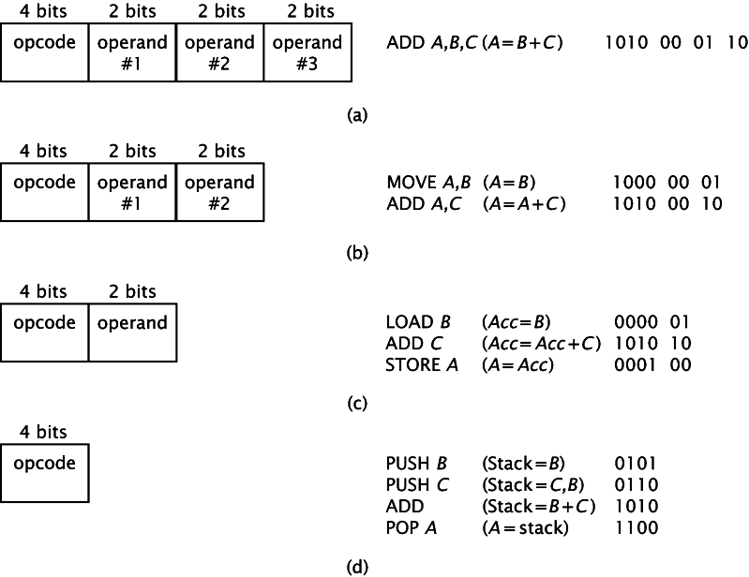
Instruction formats (2)
Notes:
Consider a simplified example A=B+C
This instruction is an addition, with two source operands (B and C) and a destination operand (A)
If we are using 4 bits to represent the opcode of the instruction, then we will have 16 possible operations, including the addition. Assume that the bit pattern 1010 represents the addition operation.
For this example, there are four possible operands (2 bits representation). For this example A is 00, B is 01, C is 10 and D is 11.
A microprocessor can be designed with instructions that can take 3, 2, 1 or no operand. The possible format instructions for those cases are presented.

Slide 13
Instruction formats (3)
Fewer operands translates into more instructions to accomplish the same task
The hardware required to implement the microprocessor becomes less complex with fewer operands; microprocessors whose instructions specify a fewer number of operands can execute instructions more quickly than those that specify more operands
The example was simplified to show the difference between three, two, one and zero operands instructions; in practice, the instructions require many more bits than used in these examples; an operand field may specify an arbitrary memory address, rather than one of the four registers; this could require 16, 32 or even more bits per operand

Slide 14
CPU Elements
Program Counter or PC contains the address of the instruction that will be executed next
Stack – a data structure of last in first out type
    A stack is described by a special register – stack pointer
  It can be used explicitly to save/restore data
  It is used implicitly by procedure call instructions (if available in the instruction set)
IR – instruction register that holds the current instruction being processed by the microprocessor; it is not exposed through the instruction set architecture; just an organization element

Slide 15
Addressing Modes
An architecture addressing mode is the set of syntaxes and methods that instructions use to specify a memory address
  For operands or results
  As a target address for a branch instruction
When a microprocessor accesses memory, to either read or write data, it must specify the memory address it needs to access
Several addressing modes to generate this address are known, a microprocessor instruction set architecture may contain some or all of those modes, deepening on its design
In the following examples we will use the LDAC instruction (loads data from a memory location into the AC - accumulator - microprocessor register)

Slide 16
Direct mode
Instruction
Memory
Opcode
Address A
Operand
Instruction includes the A memory address
LDAC 5 – accesses memory location 5, reads the data (10) and stores the data in the microprocessor’s accumulator
This mode is usually used to load variables and operands into the CPU

Slide 17
Indirect mode
Instruction
Memory
Opcode
Address A
Pointer to operand
Starts like the direct mode, but it makes an extra memory access. The address specified in the instruction is not the address of the operand, it is the address of a memory location that contains the address of the operand.
LDAC @5 or LDAC (5), first retrieves the content of memory location 5, say 10, and then CPU goes to location 10, reads the content (20) of that location and loads the data into the CPU
operand

Slide 18
Register direct mode
Instruction
Registers
Opcode
Register Address R
Operand
It specifies a register instead a memory address
LDAC R – if register R contains an value 5, then the value 5 is copied into the CPU’s accumulator
No memory access
Very fast execution
Very limited address space

Slide 19
Register indirect mode
Instruction
Registers
Memory
Opcode
Register Address R
Pointer to
operand
Operand
LDAC @R or LDAC (R) – the register contains the address of the operand in the memory
Register R (selected by the operand), contains value 5 which represents the address of the operand in the memory (10)
One fewer memory access than indirect addressing

Slide 20
Immediate mode
The operand is not specifying an address, it is the actual data to be used
LDAC #5 loads actually value 5 into the CPU’s accumulator
No memory reference to fetch data
Fast, no memory access to bring the operand

Slide 21
Implicit addressing mode
Doesn’t explicitly specify an operand
The instruction implicitly specifies the operand because always applies to a specific register
This is not used for load instructions
As an example, consider an instruction CLAC, that is clearing the content of the accumulator in a processor and it is always referring to the accumulator
This mode is used also in CPUs that do use a stack to store data; they don’t specify an operand because it is implicit that the operand must come from the stack

Slide 22
Displacement addressing mode
Instruction
Memory
Opcode
Register R
Address A
Pointer to
Operand
+
Operand
Registers
Effective Address = A + (content of R)
Address field hold two values
  A = base value
  R = register that holds displacement
  or vice versa

Slide 23
Relative addressing mode
It is a particular case of the displacement addressing, where the register is the program counter; the supplied operand is an offset; Effective Address = A + (PC)
The offset is added to the content of the CPU’s program counter register to generate the required address
The program counter contains the address of next instruction to be executed, so the same relative instruction will produce different addresses at different locations in the program
Consider that the relative instruction LDAC $5 is located at memory address 10 and it takes two memory locations; the next instruction is at location 12, so the operand is actually located at (12 +5) 17; the instruction loads the operand at address 17 and stores it in the CPU’s accumulator
This mode is useful for short jumps and relocatable code

Slide 24
Indexed addressing mode
Works like relative addressing mode; instead adding the A to the content of program counter (PC), the A is added to the content of an index register
If the index register contains value 10, then the instruction LDAC 5(X) reads data from memory at location (5+10) 15 and stores it in the accumulator
Good for accessing arrays
  Effective Address = A + IndexReg
  R++

Slide 25
Based addressing mode
Works the same with indexed addressing mode, except that the index register is replaced by a base address register
A holds displacement
R holds pointer to base address
R may be explicit or implicit
e.g. segment registers in 80x86

Slide 26
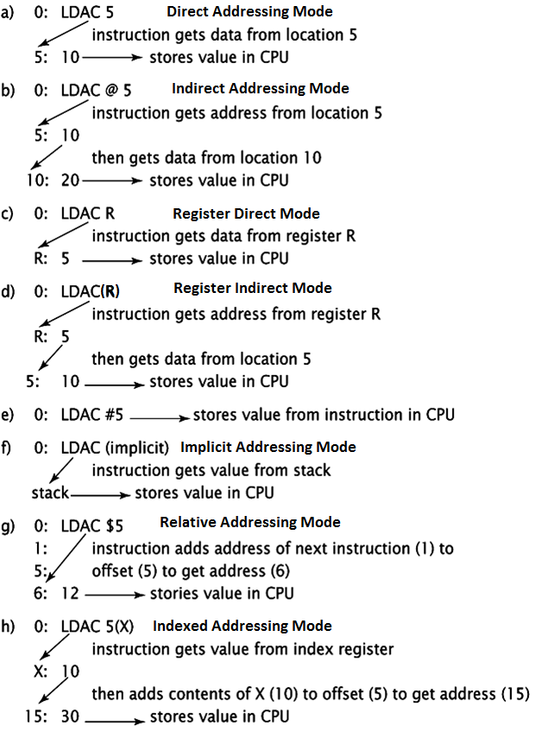
Addressing Modes Summary

Slide 27
Multimedia Vector Instructions (1)
Are designed to improve performance on multimedia applications
  Audio/Video compression/decompression
They perform same sequence of operation on large number of independent data objects
  i.e. 8X8 blocks of compressed pixels
Those instructions are often described as SIMD (Single Instruction Multiple Data)
  or data parallelism because multiple data objects can be processed at the same time
  Video pixels (described by 8 bit values for Red, Green and Blue) are example of this kind of data

Slide 28
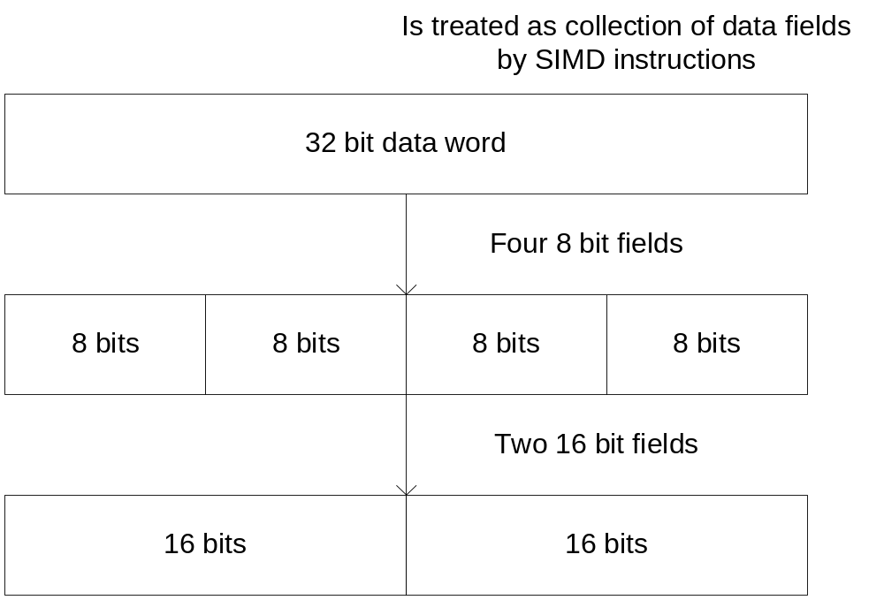
Multimedia Vector Instructions (2)
SIMD instructions treat the processor’s data word as a collection of smaller data objects

Slide 29
Multimedia Vector Instructions (3)
Many multimedia vector instructions allow the operation in saturating arithmetic mode
  Computations that overflow the number of bits in their representation return the max value of that data representation
When a multimedia vector instruction is executed, it performs its computation in parallel for each small objects in the input word
Notes:
In example, adding 0xaa and 0x99 in saturating arithmetic mode returns 0xff instead of 0x43 … that is useful for instance when it is desirable to have a computation limit by its maximum value (for instance the value of red in an picture … adding two high red values, doesn’t have to yield a low red value …)

Slide 30
Example of saturated arithmetics
In a video application, adding 0xaa and 0x99 in saturating arithmetic mode returns 0xff instead of 0x43 …
  that is useful for instance when it is desirable to have a computation limit by its maximum value
  for instance the value of red in an picture … adding two high red values, can’t yield a low red value …

Slide 31
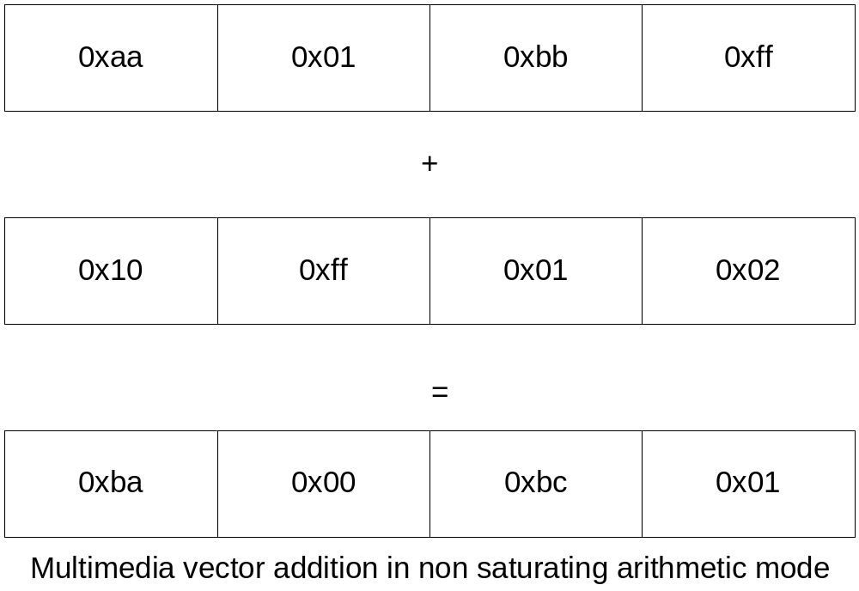
Multimedia Vector Instructions (4)
Each of the four 8 bit additions are executed in parallel
The results of any one addition doesn’t affect the result of any other addition
Notes:
Multimedia vector instructions can significantly improve a processor performance on data parallel applications. For instance, 32 bit multimedia vector instruction can be used to compute the red color of four pixels in parallel.

Slide 32
Fixed Length vs. Variable Length Instruction Encoding
Fixed Length Instructions
  Use same number of bits to encode each instruction in the ISA
  Simple to decode
  Hardware can predict the location of next instruction (easier for the processor to use pipeline)
  More common in recent architectures
Variable Length Instructions
  Uses different number of bits to encode the instructions in ISA, depending on the number of inputs to the instruction, the addressing modes, etc…
  Can reduce the amount of space taken by a program
  Increases the complexity of the implementation of decoding unit
  The hardware can’t predict the location of next instruction until the current one is decoded
Notes:
Pipeline is overlapping the execution of multiple instructions.

Slide 33
Instruction set architecture design (1)
What is the processor able to do
  General Purpose Processor
    If will be general purpose, then the ISA should be pretty rich to perform a variety of tasks
  Specialized Processor
    the ISA should perform a specific set of tasks, well known in advance
The instruction set has to have all the instructions to perform its required tasks – completeness
What addressing modes?
Multimedia instructions?
RISC or CISC? Fixed length encoding or variable length encoding?
The instruction set should be orthogonal (CISC specific)
  The choice of addressing mode is independent from the choice of instruction. Any instruction that references memory should be able to use any implemented addressing mode
  an orthogonal instruction set allows a programmer to remember fewer instructions ("ADD", "SUBTRACT", "MULTIPLY", "DIVIDE", etc.) and a set of three to ten addressing modes ("FROM REGISTER 0", "FROM REGISTER 1", "FROM MEMORY", etc)

Slide 34
Instruction set architecture design (2)
Does the microprocessor have to be backwards compatible with other microprocessors?
What type of data and sizes of data will the microprocessor deal with??
  If floating point operation is needed, then the design must include instructions that will work on floating point data; also registers to store floating point data are needed;
Are interrupts needed?
  If needed, the design should include the registers and instructions to deal with interrupts
Are conditional instructions needed?
  Usually, the conditions are stored in 1-bit registers that store the value of various conditions; typical flags include the zero flag (set 1 when an operation produces a result of zero), sign flag (set to one when an instruction produces an negative result), etc…

Slide 35
Processor Microarchitecture
The ISA provides details about how the processor is programmed and the microarchitecture specifies how it is build.
If ISA is simple – simple microarchitecture
If ISA is complex – complex microarchitecture
Three main components
  Execution units
  Register file
  Control logic

Slide 36
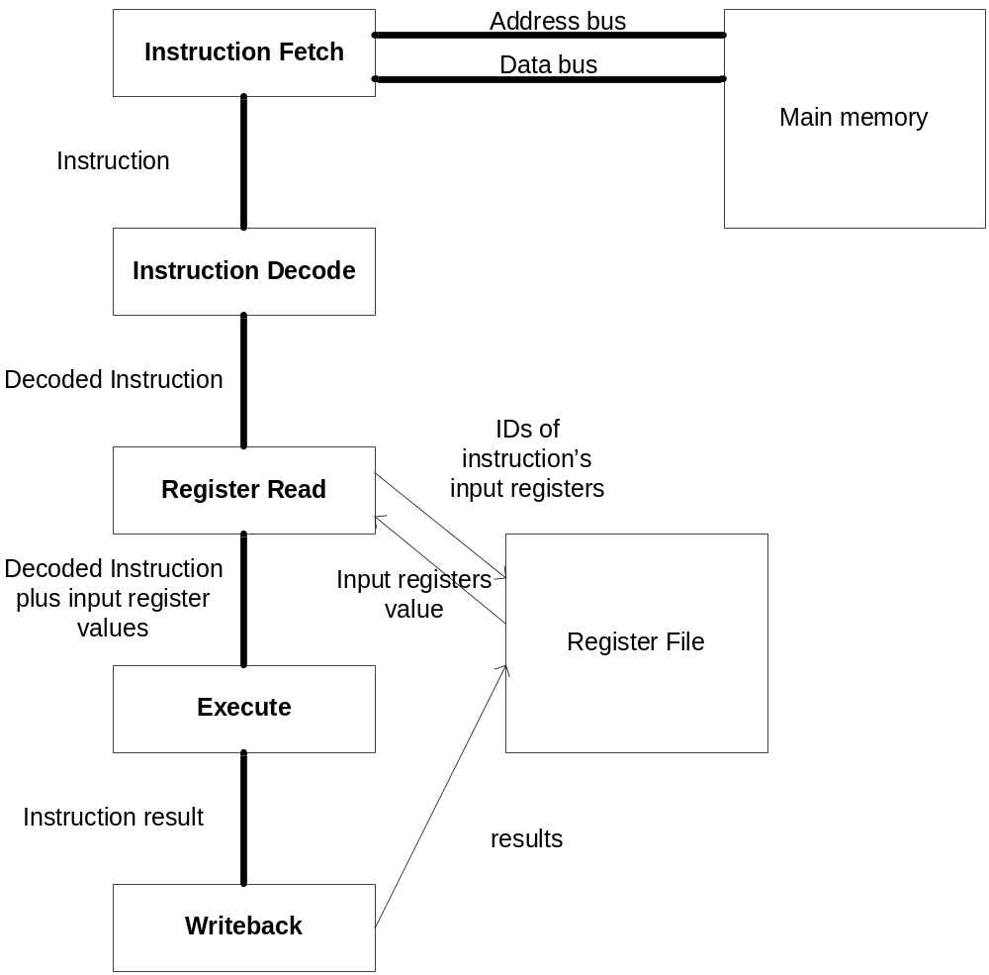
Instruction Execution
Notes:
This figure shows the steps involved in executing an instruction and how the different module of the processor interact during the instruction execution. First the processor fetches the instruction from the memory, then the instruction is decoded, to determine what instruction it is and what its input and output registers are. The decoded instruction is represented as a bit pattern that tell the hardware how to execute the instruction. These bit patterns are sent to the next section of the execution unit that reads the input registers from the register file (or from the memory if the operands are stored in the memory). The decoded instruction and the values of the input registers are sent to the next unit (the functional unit) that computes the result of the instruction. The result is written back into the register file.
The physical structure of many execution units is similar to the one presented in this slide. Modules that implement the different steps are laid out next to each other, with short wires connecting them. As the instruction executes, the data flows from one module to the next, with each module performing its task in sequence.

Slide 37
Register File Design
Number of registers
  Too few registers will cause too many accesses to the main memory thus reducing performance
  Too many registers would be overkill for specialized microcontrollers
Type of registers
  Usually, if the processor supports floating point data (and instructions on floating point numbers) than two separate register files will be designed:
    Integer registers
      Usually referenced using the “rx” syntax
    Floating point register
      Usually referenced using the “fx” syntax

Slide 38
References
“Computer Systems Organization & Architecture”, John D. Carpinelli, ISBN: 0-201-61253-4
“Computer Architecture”, Nicholas Charter, ISBN – 0-07-136207

Slide 39
Additional slides

Slide 40
Microprogramming (1)
In a microprogrammed processor, the hardware doesn’t directly execute the instructions in the ISA
  The hardware executes very simple micro-operations that are used to implement the instructions
  Each instruction specifies a sequence of micro-operations that are used to implement the instructions
Each instruction in the ISA is translated into a sequence of micro-operations by the hardware
  Similar to how a compiler translates each high level instruction into sequences of assembly language instructions

Slide 41
Microprogramming (2)
Example ADD r1, r2, r3
  Could get translated into six micro-operations:
    One that reads the value of r2 and sends it to one input of the adder
    One that reads the value of r3 and sends it to the other input of the adder
    One that performs the actual addition
    One that writes the result of the addition into r1
    One that increments the program counter to the next instruction
    One that fetches the next instruction from the memory
  Each micro-instruction takes in general one processor clock to execute, so the add instruction in our case would take six clock cycles to execute

Slide 42
Microprogramming (3)
Microprogrammed processors have a small memory that holds the sequences of microinstructions used to implement each instruction in the ISA
To execute an instruction, the processor will have to lookup the memory location that contains the microinstructions used to implement the ISA instruction, and then executes those microinstructions in sequence
Microprogramming was very used in the past, due to inability to integrate too much hardware into the processors

